Slide 1


AIR QUALITY PREDICTION IN URBAN AREAS
TEAMCODE: S4F_CP_Team_12227

Slide 2
Content
Abstract
Problem Statement
Objective
Data Collection and Preparation
Proposed Solution (Methodology)
Model Performance Evaluation
Screenshots / Demonstration (video)
Future Scope
Conclusion
Notes:
Abstract
Problem Statement (Clearly define the challenge)
Objective (State your project's goal)
Background and Research (Discuss existing solutions, trends, and gaps)
Data Collection and Preparation (Focus on data sources, cleaning, and augmentation)
Proposed Solution (Methodology)
Model Architecture (e.g., CNN, U-Net, YOLOv5)
Key Techniques (e.g., Transfer Learning, Image Augmentation)
Model Performance Evaluation
Metrics (Accuracy, Precision, Recall, IoU, etc.)
Graphs (Confusion Matrix, ROC Curve, etc.)
Screenshots / Demonstration (Visual proof of system functionality)
Future Scope (Improvements, scalability, and integration ideas)
Conclusion (Summarize results and impact)
Q&A Session

Slide 3
Abstract
    Air pollution is a critical global issue affecting human health and the environment. Predicting air quality levels is essential for implementing preventive measures and mitigating pollution. This project utilizes Machine Learning (ML) models to predict the Air Quality Index (AQI) based on various environmental factors such as PM2.5, PM10, NO2, CO, temperature, humidity, wind speed, and traffic density.
A Support Vector Regression (SVR) model was trained using historical air quality data to forecast AQI levels. The dataset was preprocessed by standardizing features, and the model’s performance was evaluated using Mean Absolute Error (MAE) and Root Mean Squared Error (RMSE).

Slide 4
Problem Statement
Air pollution is a growing environmental and public health crisis, particularly in urban areas with high traffic density and industrial activity. The Air Quality Index (AQI) is a critical measure used to assess pollution levels and their potential impact on human health. However, traditional air quality monitoring methods often fail to provide timely forecasts, making it difficult for authorities to take proactive measures.
The challenge lies in accurately predicting AQI based on multiple environmental factors such as particulate matter (PM2.5, PM10), nitrogen dioxide (NO2), carbon monoxide (CO), temperature, humidity, wind speed, and traffic density.

Slide 5
Objective
1. Develop a Predictive Model:
Train a Support Vector Regression (SVR) model to forecast AQI based on key environmental factors such as PM2.5, PM10, NO2, CO, temperature, humidity, wind speed, and traffic density.
2.Evaluate Model Performance:
Assess the accuracy of the model using Mean Absolute Error (MAE) and Root Mean Squared Error (RMSE).
3.Integrate with Smart City Solutions:
Explore how the model can be linked with a city’s traffic management system to reduce congestion and lower emissions.
4.AI-Driven Pollution Mitigation:
Demonstrate the role of Artificial Intelligence (AI) in air pollution control.
Highlight how developing countries can leverage AI-driven forecasting to implement better environmental policies.

Slide 6
Data Collection and Preparation
The dataset used for this project consists of historical air quality data collected from environmental monitoring stations. The data includes key air pollution indicators and meteorological parameters. The primary sources of data include:
Government and Environmental Agencies (e.g., CPCB, EPA, WHO)
Real-time Air Quality Monitoring Stations
Weather APIs and Traffic Management Systems
Public Datasets from Kaggle and other repositories

Slide 7
Proposed Solution (Methodology)
Data Acquisition and Preprocessing
✅ Data Collection:
Gather real-time and historical air quality data from government agencies, sensors, weather APIs, and traffic management systems.
Extract essential features such as PM2.5, PM10, NO2, CO, temperature, humidity, wind speed, and traffic density.
2. Model Development
✅ Model Selection:
Support Vector Regression (SVR) is chosen for its effectiveness in handling non-linear relationships in AQI prediction.
Time Series Forecasting (LSTM or ARIMA) is explored for predicting AQI 24 hours in advance.

Slide 8
Model Performance Evaluation
1.Performance Results
After training the SVR model with standardized features and evaluating it on the test dataset, the following results were obtained:​
Mean Absolute Error (MAE): 29.828​
Root Mean Squared Error (RMSE): 41.330​
R-squared (R²) Score: 0.6814​
2.Comparative Analysis
To contextualize the SVR model's performance, it's beneficial to compare it with other machine learning models applied to similar AQI prediction tasks:​
CatBoost Model:
  MAE: 0.60​
  MSE: 0.58​
  RMSE: 0.76​
  R² Score: 0.9998

Slide 9
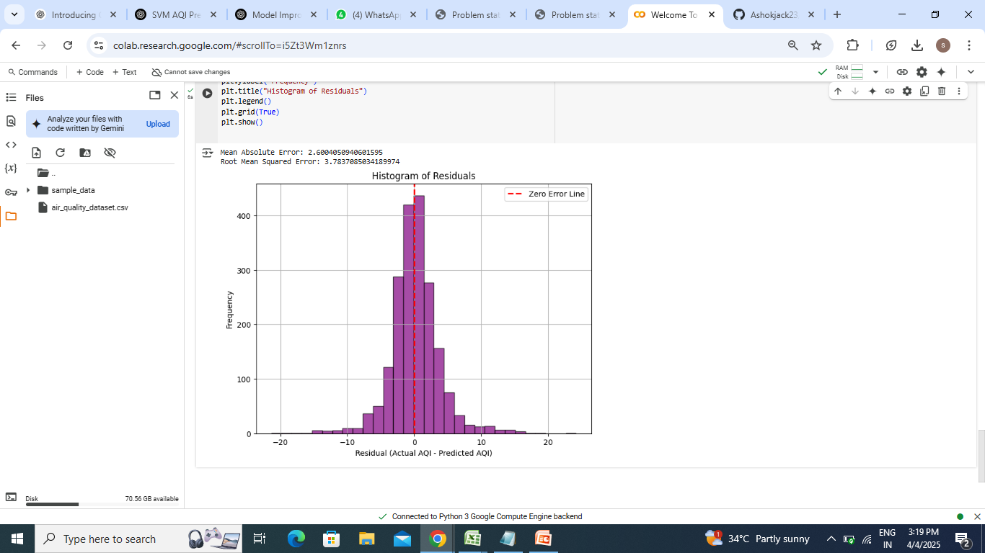
Screenshots / Demonstration (video)
https://colab.research.google.com/#scrollTo=i5Zt3Wm1znrs
https://github.com/Ashokjack23/Ashok

Slide 10
Future Scope
Enhanced Predictive Accuracy through Advanced AI Models.
Real-Time Data Integration.
Personalized Health Advisory Systems.
Policy Formulation and Urban Planning.
Global Applicability and Scalability.
Integration with Autonomous Vehicles.

Slide 11
Conclusion
The integration of Artificial Intelligence (AI) and Machine Learning (ML) in air quality prediction and traffic management has demonstrated significant potential in enhancing urban environmental health.
By leveraging historical data and advanced algorithms, these technologies enable accurate forecasting of Air Quality Index (AQI) levels, facilitating timely interventions to mitigate pollution.
Moreover, AI-driven traffic management systems optimize traffic flow, reducing congestion and vehicular emissions, thereby contributing to improved air quality.

